Slide 1





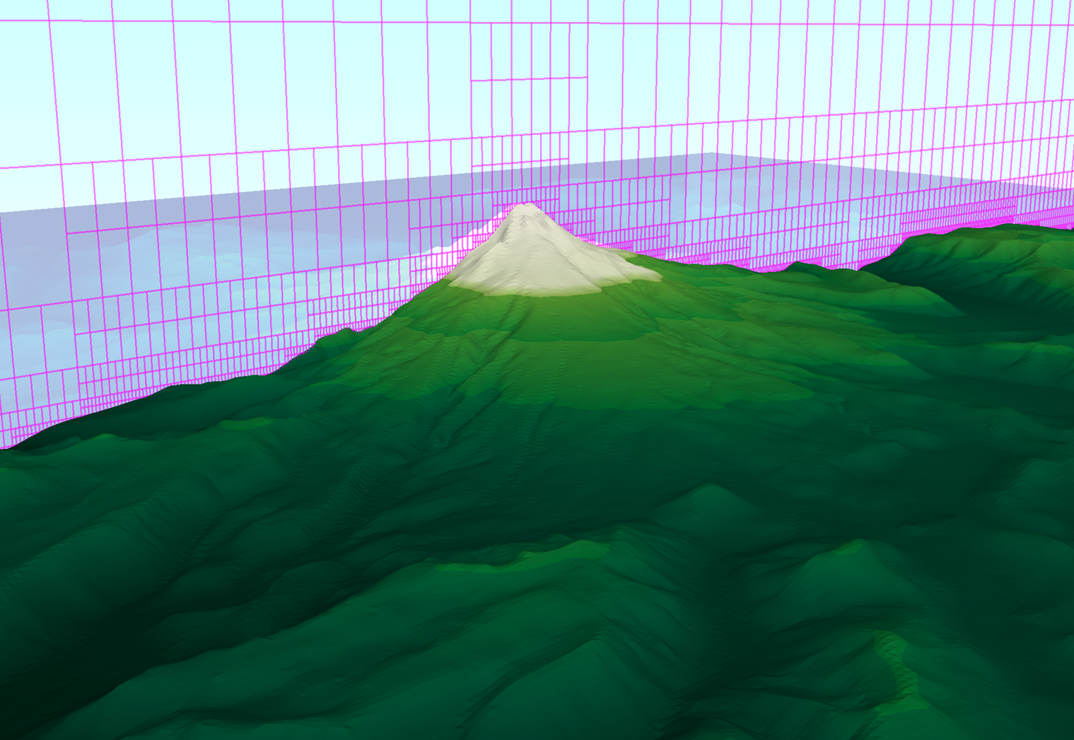
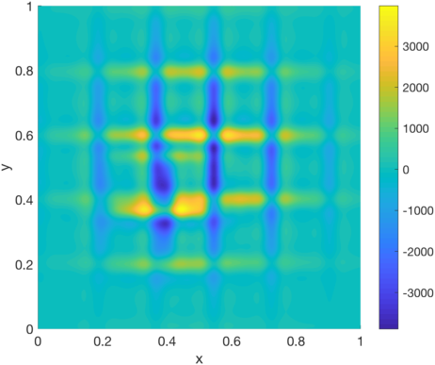
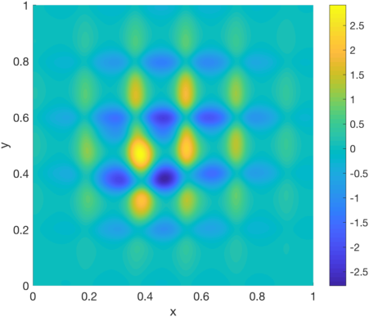
Massively Parallel Solvers for Computational Fluid Dynamics on Multi-block Cartesian Grids
Research supported by
Scott Aiton
Brenton Peck
Donna Calhoun
Grady B. Wright
FPK 900-034
ACI-1440638
Introduction
Domain Decomposition
Schur Complement Linear System
Computational fluid dynamics (CFD) plays a central role in numerical weather prediction (NWP) models for forecasting and understanding the Earth as a system. Often these models produce results with large uncertainty and can fail to predict the intensity of weather events with desired accuracy. This is especially true for forecasting microscale wind over arbitrarily complex terrain, which is one of the least understood subjects in the atmospheric sciences, but is fundamental to many crucial problems, such as predicting microscale contaminant dispersion. Growing evidence indicates that these shortcomings arise from a combination of inadequate modeling of microscale physical processes within the Earth’s atmosphere and inherent numerical errors in the CFD methods.
To address these shortcomings, the PIs are developing a massively parallel, open-source CFD software package GEM3D to study microscale atmospheric flows over complex terrain with numerical resolutions that are much finer than any current software allows. Our package uses block structured Cartesian adaptive mesh refinement (AMR) methods to provide a practical, accurate method for geometrically modeling complex terrain and large-eddy simulation techniques with novel dynamic sub-grid scale models for physically modeling incompressible flows in complex terrain.
Block structured Cartesian AMR is naturally set up for a domain decomposition (DD) approach for solving the Pressure Poisson problem.
The interface values can first be computed directly by solving the Schur Complement Linear System:
Simple Block AMR For Explaining DD
Transform the Pressure Poisson problem (1) to solving
(3)
Comments:
(2)
Benefit:
Highly efficient fast Fourier transform (FFT) based methods can be used to solve each subdomain problem in
Illustration of the Schur complement matrix for the 9 uniform blocks with n=16
Illustration of the Schur complement matrix for the 130 AMR blocks with n=16
To make near-real time forecasting possible, the software is being designed and developed to exploit the massively parallel, multi-GPU (graphics processing unit) computing paradigm efficiently.
Issue:
Figure. Example of embedded boundary structured Cartesian adaptive mesh refinement (AMR) over terrain generated by the GEM3D code. Only a vertical slice of the grid is shown in magenta.
Pressure Poisson equation
Finite-difference Discretization
Solving the Pressure Poisson equation is one of the key challenges in CFD models for incompressible flows. The equation arises from the condition that the velocity of the fluid remain incompressible. Solving the equation is often the dominating computational cost, as it requires solving a massive linear system of equations every time-step of a simulation.
Our strategy:
Numerical Results
Solve:
for p given f,
(1)
The following methods are compared:
(a) Domain decomposition as described above: solving the Schur complement system (3) with AMG preconditioned GMRES and then solving (2) on each subdomain using FFT based solvers.
(b) Constructing the full linear system for the discretization of (1) directly (i.e. without domain decomposition) and solving with AMG preconditioned GMRES.
We also compare these methods on CPU and GPU architectures. All runs were done on Kestrel.
GEM3D uses embedded boundary methods for dealing with complex geometries, which allows us to focus on solving the Pressure Poisson equation on rectangular domains.
Software libraries:
Focus of this poster is on 2D rectangular domains
CPU: HYPRE (BoomerAMG); PETSc (GMRES); FFTW (Fast Cosine/Sine transforms)
GPU: NVIDIA Linear Algebra Library (AMGx) and Signal Library (cuFFT); code compiled under CUDA 7.5.
Timing results for approximating (1)
Details:
We can extend these discretizations to more complicated block structured
AMR settings:
8320 AMR blocks with 16-by-16 grids per block, which gives 8,519,680 degrees of freedom
Method of manufactured solution used to validate the code
For AMGx, proc(s) and p means number of GPUs used
GMRES relative tolerance= 10^{-12,} and restart is 40
AMG preconditioner uses 1 v-cycle with 1 pre/post smooth
CPU: 2.4 GHz Intel Xeon E5-2600;
2 processor per node;
64GB memory per node
GPU: NVIDIA Tesla K20;
2 GPUs per node;
5GB memory per GPU
Mellanox ConnectX-3FDR Infiniband interconnect
Use conservation of fluxes to derive stencils at the boundaries
Use bi-cubic interpolation to define interface equations for 𝛾_{i}
Block Structured Cartesian AMR
Linear System of Equations
We use a nested hierarchy of fixed size, non-overlapping, Cartesian grids to discretize the rectangular domains.
Benefits:
Use fine grids to capture localized, small-scale features of the problems and coarse grids in regions with large-scale features.
Use standard finite difference/volume schemes to discretize the equations.
We can arrange the finite difference and interface equations in to a sparse linear system of equations:
Illustration of the matrix for the 9 uniform blocks with n=16
Illustration of the matrix for the 30 AMR blocks with n=16
We enforce a constant 2:1 refinement ratio between grid levels.
Example of Block Structured AMR
Block AMR with 8-by-8 grids
Outlines show the equations for the 9 non-overlapping subdomains and interface conditions.
Outlines of the blocks not included here since the resulting image is too messy.
Remarks:
130 blocks
8320 grid points
Finest resolution 1/512
The Schur complement domain decomposition method is faster than just using GMRES/AMG on the full system.
The GPU versions of the solvers are anywhere from 5 to 16 times faster than the respective CPU versions.
NVIDIA’s GMRES and AMGx methods have inconsistent behavior in terms of iterations on multi-GPUs.
We are in the process of extending the Schur complement domain decomposition method to 3D, developing better preconditioners than AMG for this system, and running the code on larger machines.
All codes are available at https://github.com/GEM3D/pressurePoissonSolver.

